Slide 1
Functions
f(x)
SoftUni Team
Technical Trainers
Software University
http://softuni.bg

Slide 2
Table of Content
Declaring/Invoking Functions
Arrow Functions
Nested Functions
Naming and Best Practices

Slide 3
Have a Question?
sli.do
#tech-js

Slide 4

JavaScript Functions Overview
Declaring and Invoking Functions

Slide 5
Functions in JS
Function == named piece of code
Can take parameters and return result
Use camel-case
Function parameter
function printStars(count) {
console.log("*".repeat(count));
}

Slide 6
Why Use Functions?
More manageable programming
Splits large problems into small pieces
Better organization of the program
Improves code readability
Improves code understandability
Avoiding repeating code
Improves code maintainability
Code reusability
Using existing functions several times

Slide 7
Function Without Parameters
Executes the code between the brackets
Does not return result
Prints result on the console
function multiplyNumbers() {
let result = 5 * 5;
console.log(result);
}
multiplyNumbers(); //25

Slide 8
{…}
Declaring and Invoking Functions
Notes:
Add Image!

Slide 9
Declaring Function
Function Name
Parameters
function printText(text){
console.log(text);
}
Function Body
Variables of type "let" inside a function
Functions can have several parameters
It is possible for function to not return a value

Slide 10
Invoking a Function
Functions are first declared, then invoked (many times)
Functions can be invoked (called) by their name:
function printHeader(){
console.log("----------");
}
Function Declaration
function main(){
printHeader();
}
Function Invocation

Slide 11
Invoking a Function (2)
A function can be invoked from:
Other functions
Itself (recursion)
function printHeader() {
printHeaderTop();
printHeaderBottom();
}
Function invoking functions
function crash() {
crash();
}
Function invoking itself

Slide 12
Problem: Car Tax Calculator
Write a function that receives a power in kW of car’s, between 0.00 and 150.00, and calculates and prints the tax you have to pay in lv.
under 37 kW - 0.43 lv./kW
37.01 – 55 kW - 0.50 lv./kW
55.01 – 74.00 - 0.68 lv./kW
74.01 – 110.00 - 1.38 lv./kW
up 110.00 - 1.54 lv./kW
Input
Output
57.50
39.10 lv.

Slide 13
Solution: Car Tax Calculator
function solve(kW) {
let power = Number(kW);
calculate(power);
}
function calculate(power) {
let tax = 0;
if (power > 110 ){
tax = power * 1.54;
} else if (power > 74 ){
tax = power * 1.38;
} else //TODO
tax = tax.toFixed(2);
console.log(tax + ' lv.');
}
Check your solution here: https://judge.softuni.bg/Contests/1230/Functions-Lab

Slide 14
Problem: Car Tax Calculator II
Add a new tax calculation function to the previous code
Receive two parameters
Kilowatts
Car age
The coefficient depends on the age of the vehicle
Under 5 years - 2.80
5 - 14 year - 1.50
Up to 14 - 1.00
Input
Output
45, 10
33.75 lv.

Slide 15
Solution: Car Tax Calculator II
function solve(kW, age) {
let coefficient = calcCoeff(age);
let powerPrice = calcPowerPrice(kW);
totalPrice = (powerPrice * coefficient).toFixed(2) + " lv.";
console.log(totalPrice);
}
function calcCoeff(age) {
let coefficient = 0;
if (age > 14){
coefficient = 1;
} else //TODO
return coefficient;
} //TODO: implement the calcPowerPrice function
Check your solution here: https://judge.softuni.bg/Contests/1230/Functions-Lab

Slide 16
() => {}
Arrow Functions

Slide 17
Arrow Functions
Functions in JS can be written in short form using
"=>" (arrow)
let increment = x => x + 1;
console.log(increment(5)); // 6
This is the same as the above function
let increment = function(x) {
return x + 1;
}
let sum = (a, b) => a + b;
console.log(sum(5, 6)); // 11

Slide 18
Problem: Simple Calculator
Write a function that receives three parameters and write an arrow function, that calculates a result depending on operator
The operator can be 'multiply', 'divide', 'add', 'subtract'
The input comes as three parameters - two numbers and an operator as a string
Input
Output
5, 10, 'multiply'
25

Slide 19
Solution: Simple Calculator
function solve(a, b, operator) {
switch (operator) {
case 'multiply':
let multyiply = (a, b) => a * b;
console.log(multyiply(a, b));
break;
case 'divide':
//TODO
case 'add':
//TODO
case 'subtract':
//TODO
}
}
Check your solution here: https://judge.softuni.bg/Contests/1230/Functions-Lab

Slide 20
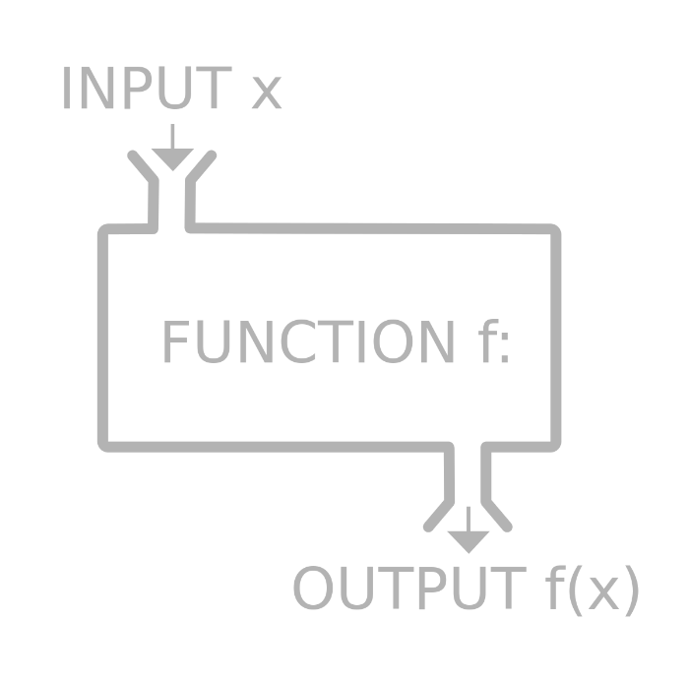
Nested Functions

Slide 21
Example
Functions in JS can be nested, i.e. hold other functions
Inner functions have access to variables from their parent
Main function
function drawDiamond(size) {
drawTop(size / 2)
drawBottom(size / 2)
}
Nesting the functions

Slide 22

Problem: Car Tax Calculator III
Add new functionality to the calculator for the motorcycle tax
Parameters:
First – vehicle type
Second – engine's volume
Third - years
Input
Output
'motorcycle', 450, 10
63.00 lv.

Slide 23
Solution: Car Tax Calculator III
function solve(type, kW, age) {
switch (type){
case "motorcycle":
totalCalc(kW);
break;
case "car":
let result = totalCalc(powerCalc(kW),calcCoeff(age));
console.log(result);
break;
}
} //TODO: implement the other functions
Check your solution here: https://judge.softuni.bg/Contests/1230/Functions-Lab

Slide 24

Naming and Best Practices

Slide 25


Naming Functions
Functions naming guidelines
Use meaningful function names
Should be in camelCase
Function names should answer the question:
What does this function do?
If you cannot find a good name for a function, think about whether it has a clear intent
findStudent, loadReport, sine
Method1, DoSomething, handleStuff, DirtyHack

Slide 26
Naming Function Parameters
Function parameters names
Preferred form: [Noun] or [Adjective] + [Noun]
Should be in camelCase
Should be meaningful
Unit of measure should be obvious
firstName, report, speedKmH, usersList, fontSizeInPixels, font
p, p1, p2, populate, LastName, last_name, convertImage

Slide 27
Functions – Best Practices
Each function should perform a single, well-defined task
A Function’s name should describe that task in a clear and non-ambiguous way
Avoid functions longer than one screen
Split them to several shorter functions
function printReceipt(){
printHeader();
printBody();
printFooter();
}
Self documenting and easy to test

Slide 28

Code Structure and Code Formatting
Make sure to use correct indentation
Leave a blank line between functions, after loops and after if statements
Always use curly brackets for loops and if statements bodies
Avoid long lines and complex expressions
function main(){
// some code…
// some more code…
}
function Main()
{
// some code…
// some more code…
}

Slide 29

Summary
Functions:
Break large programs into simple functions that solve small sub-problems
Consist of declaration and body
Are invoked by their name
Can accept parameters
…
…
…

Slide 30
https://softuni.bg/courses/technology-fundamentals

Slide 31













SoftUni Diamond Partners

Slide 32




SoftUni Organizational Partners

Slide 33




Trainings @ Software University (SoftUni)
Software University – High-Quality Education and Employment Opportunities
softuni.bg
Software University Foundation
http://softuni.foundation/
Software University @ Facebook
facebook.com/SoftwareUniversity
Software University Forums
forum.softuni.bg

Slide 34

License
This course (slides, examples, demos, videos, homework, etc.) is licensed under the "Creative Commons Attribution-NonCommercial-ShareAlike 4.0 International" license

